Slide 1


VISVESVARAYA TECHNOLOGICAL UNIVERSITY “JnanaSangama”, Belagavi-590018, Karnataka, India
IMPACT COLLEGE OF ENGINEERING AND APPLIED SCIENCES
Sahakarnagar, Bengaluru – 560092
Department of Computer Science and Engineering
INTERNSHIP PRESENTATION
“STOCK MANAGEMENT SYSTEM”
INTERNAL GUIDE:
MRS. SHWETHA TJ
ASST. PROFESSOR
DEPT. OF CS&E
EXTERNAL GUIDE:
HARISH. N
Karunadu Technologies Pvt. Ltd.
PRESENTED BY:
SHUBHAM KUMAR (1IC20CS028)
DEPT. OF CS&E

Slide 2
ABSTRACT
Our innovative Stock Management System redefines inventory control. Featuring robust functionalities such as inventory tracking, inventory updating, inventory reading, and inventory deleting. Through its user-friendly interface and scalable infrastructure, the system ensures meticulous inventory accuracy, effectively mitigating stock shortages and averting surplus inventory. Because of user friendly interfaces it is cost effective. This system emerges as a cornerstone solution for enterprises spanning diverse industries, furnishing invaluable insights and fostering enduring competitive advantages. Future iterations may seamlessly integrate advanced analytics for predictive inventory optimization, amplifying its transformative potential for enterprises committed to operational excellence. Embrace the evolution of inventory oversight with our Stock Management System and reimagine the management of your inventory assets.

Slide 3
CONTENTS
Abstract
Introduction
System Requirements and Specification
Technologies Used
Methodology
Results
Conclusion
References

Slide 4
INTRODUCTION
SQL Server Management Studio Functionality: SSMS simplifies tasks like creating, modifying, and deleting databases and objects, with a robust SQL query editor.
Visual Database Design: It offers visual database design features for schema management.
Data Import/Export: Streamlines data import/export operations for efficient data movement.
Performance Optimization: Tools for performance optimization enhance database efficiency.
Security Management: Capabilities for security management ensure data protection.
Integration with Azure and Microsoft Products: Seamlessly integrates with Azure and other Microsoft products for comprehensive management.
Extensibility and Version Control: Supports extensibility with custom add-ins and integration with version control systems like Git for efficient tracking of changes.
01

Slide 5
SYSTEM
REQUIREMENTS AND SPECIFICATION
HARDWARE REQUIREMENTS:
SOFTWARE REQUIREMENTS:
Operating System: Windows
Processor: intel i3 minimum
Ram: 8 GB minimum
Hard Disk: 256 GB minimum
Programming language: C#
IDE: Visual Studio 2015
Database: SQL Server Management Studio
Google Chrome, Firefox, Microsoft Edge or Brave Browser with Extension Support.
02

Slide 6
TECHNOLOGIES USED
SQL Server Management Studio (SSMS): SSMS is a vital software application developed by Microsoft, designed specifically for the management and administration of Microsoft SQL Server databases. SSMS plays a crucial role in the realm of database management, offering a robust and user-friendly graphical interface for a wide array of database-related tasks. With SSMS, users can effortlessly connect to SQL Server instances, granting them the power to create, modify, and delete databases, tables, views, indexes, and other essential database objects.
FEATURES OF SQL SERVER:
Incremental package deployment.
Always Encrypted support.
New custom logging level.
Column names for errors in the data flow.
New connectors.
03

Slide 7
C#: It is very efficient in managing the system. All the garbage is automatically collected in C#. There is no problem of memory leak in C# because of its high memory backup. Cost of maintenance is less and is safer to run as compared to other languages. Simple and easy to learn: C# is designed to be an easy-to-learn language, especially for programmers familiar with languages like Java and C++. It has a clear syntax, which makes it easy to read and write code.
C# is a fully object-oriented language, which allows developers to create reusable code and build complex applications with ease.
Large standard library: C# has a large standard library that includes a wide range of pre-built classes and functions. This makes it easy for developers to perform common tasks without having to write a lot of custom code.
04

Slide 8
ASP .NET: It is an open source web framework, created by Microsoft, for building modern web apps and services with .NET.
ASP.NET is cross platform and runs on Windows, Linux, macOS, and Docker.
.NET is a developer platform made up of tools, programming languages, and libraries for building many different types of applications.
The base platform provides components that apply to all different types of apps. Additional frameworks, such as ASP.NET, extend .NET with components for building specific types of apps.
FEATURES OF ASP.NET:
Extremely High Performance
Support for Cross-Platform and Container Environments
Independence from a particular language
Support for Web Sockets
Globalization and Localization of Markets.
Support for HTML5 Form Types
NET Web API (Application Programming Interface).
05

Slide 9
METHODOLOGY
Inventory Management System in C# backend SQL SERVER we are going to generate this inventory management system it is also known as stock management system. Inventory Management System in C# backend SQL SERVER we are going to generate this inventory management system it is also known as stock management system.
Database Table List: Database contains one or more tables that contain information, like table for Customers information or table for Students In any given table you have several pieces of information.
Business Layer: The business-logic layer is a crucial component of a software application that handles the processing of data and implementation of business rules. It sits between the user interface (UI) layer, which is responsible for presenting data to the user, and the data access layer, which is responsible for storing and retrieving data from a database. The primary function of the business-logic layer is to process and validate user input, apply business rules, and prepare data for storage or presentation. It acts as an intermediary between the UI and data access layers, ensuring that data is properly formatted and meets the requirements of the underlying system.
06

Slide 10
Project Description: This Inventory Management System project in C# MySQL focuses mainly on keeping track of inventory activities. To be more precise, the system helps to keep track of inventories with respect to their sales. Also, the system displays all the paid, unpaid transactions of the items. In addition, the system allows managing system users and more. Evidently, this project contains an admin panel with a manager and customer panel. In an overview of this web application, an admin has full control over the system. He/she can manage employees, inventory items, and sales. Here, an admin can perform almost every work but still, the main role is to oversee the flow of the system.
07

Slide 11

Results.....
"Visualizing Stock Management: Results for Clarity and Illustration."
Efficient stock management is the cornerstone of successful businesses, ensuring the right balance between product availability and cost control.
08

Slide 12
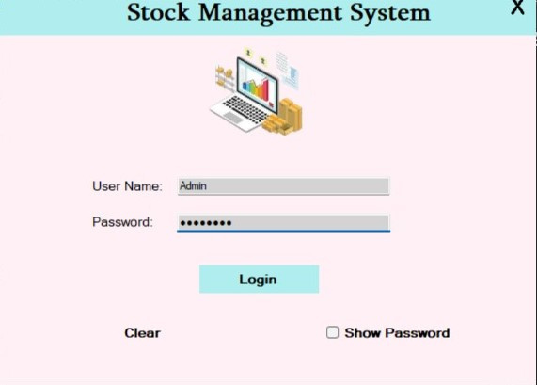
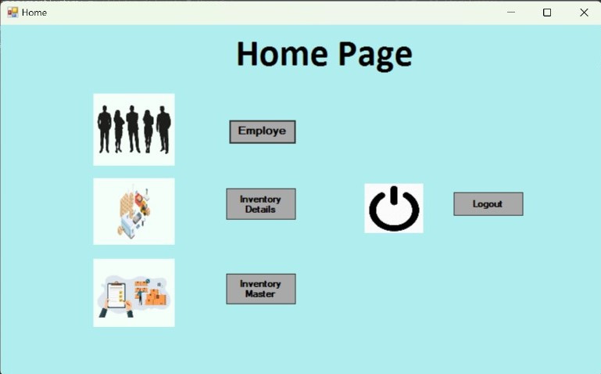
Login Page
Home Page
09

Slide 13
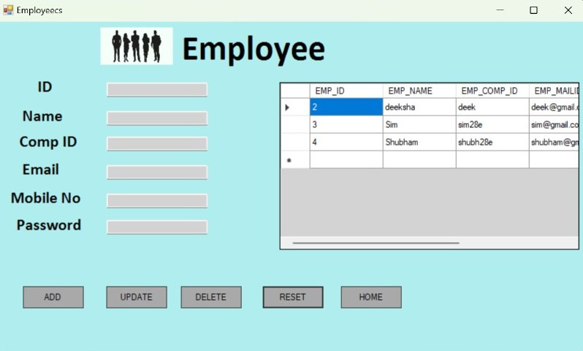
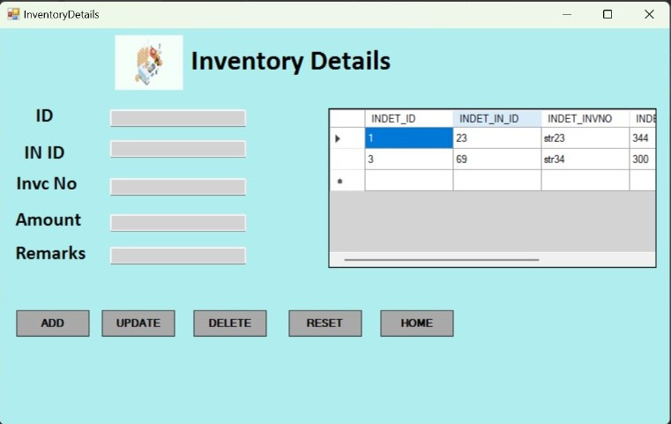
Employee Details
Inventory Details
10

Slide 14
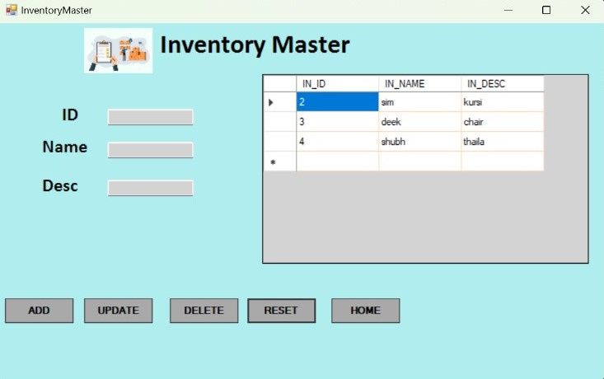
Inventory Master
11

Slide 15
CONCLUSION
In conclusion, stock management is a fundamental element of effective business operations. It enables organizations to strike the delicate balance between meeting customer demand, controlling costs, and optimizing resources. With careful planning, data-driven decision-making, and the adoption of best practices, businesses can achieve better financial results, customer satisfaction, and long-term success in today's competitive markets. Effective stock management is not merely a logistical necessity but a strategic advantage that can drive profitability and business growth.
12

Slide 16
REFERENCES
SQL Server Management studio url: https://learn.microsoft.com/enus/sql/ssms/download-sql-server-management-studio-ssms?view=sql-server-ver16.
Visual Studio 2015: https://visualstudio.microsoft.com/vs/older-downloads/
E-Commerce Store Inventory in Microsoft SQL Database.
Web Application ASP.NET: https://dotnet.microsoft.com/en-us/apps/aspnet

Slide 17

Thank You!!
Effective stock management is a key driver of business success, ensuring profitability and customer satisfaction.

